Slide 1
Wind Farms and Shipping – Friends or Foes?
BSSSC Annual Conference, Szczecin Sept 13, 2023,
Ulf Siwe, EUSBSR PA Safe / Swedish Maritime Administration
ulf.siwe@sjofartsverket.se

Slide 2
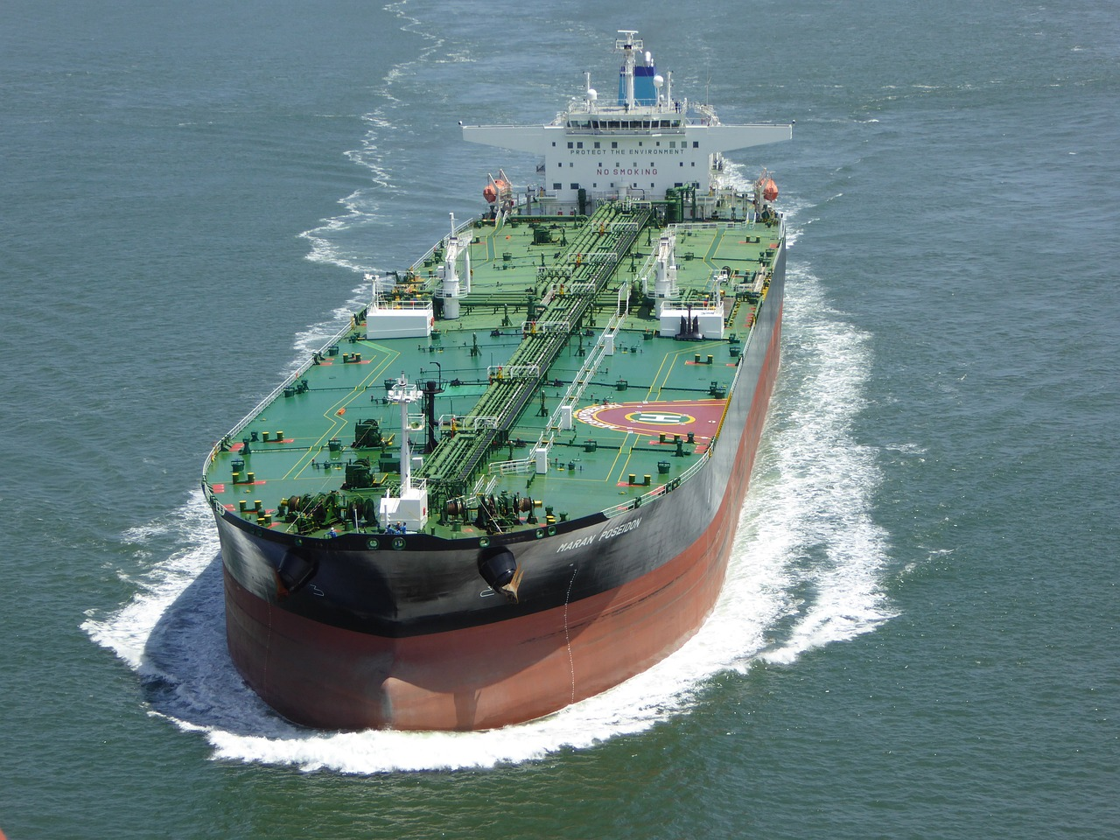
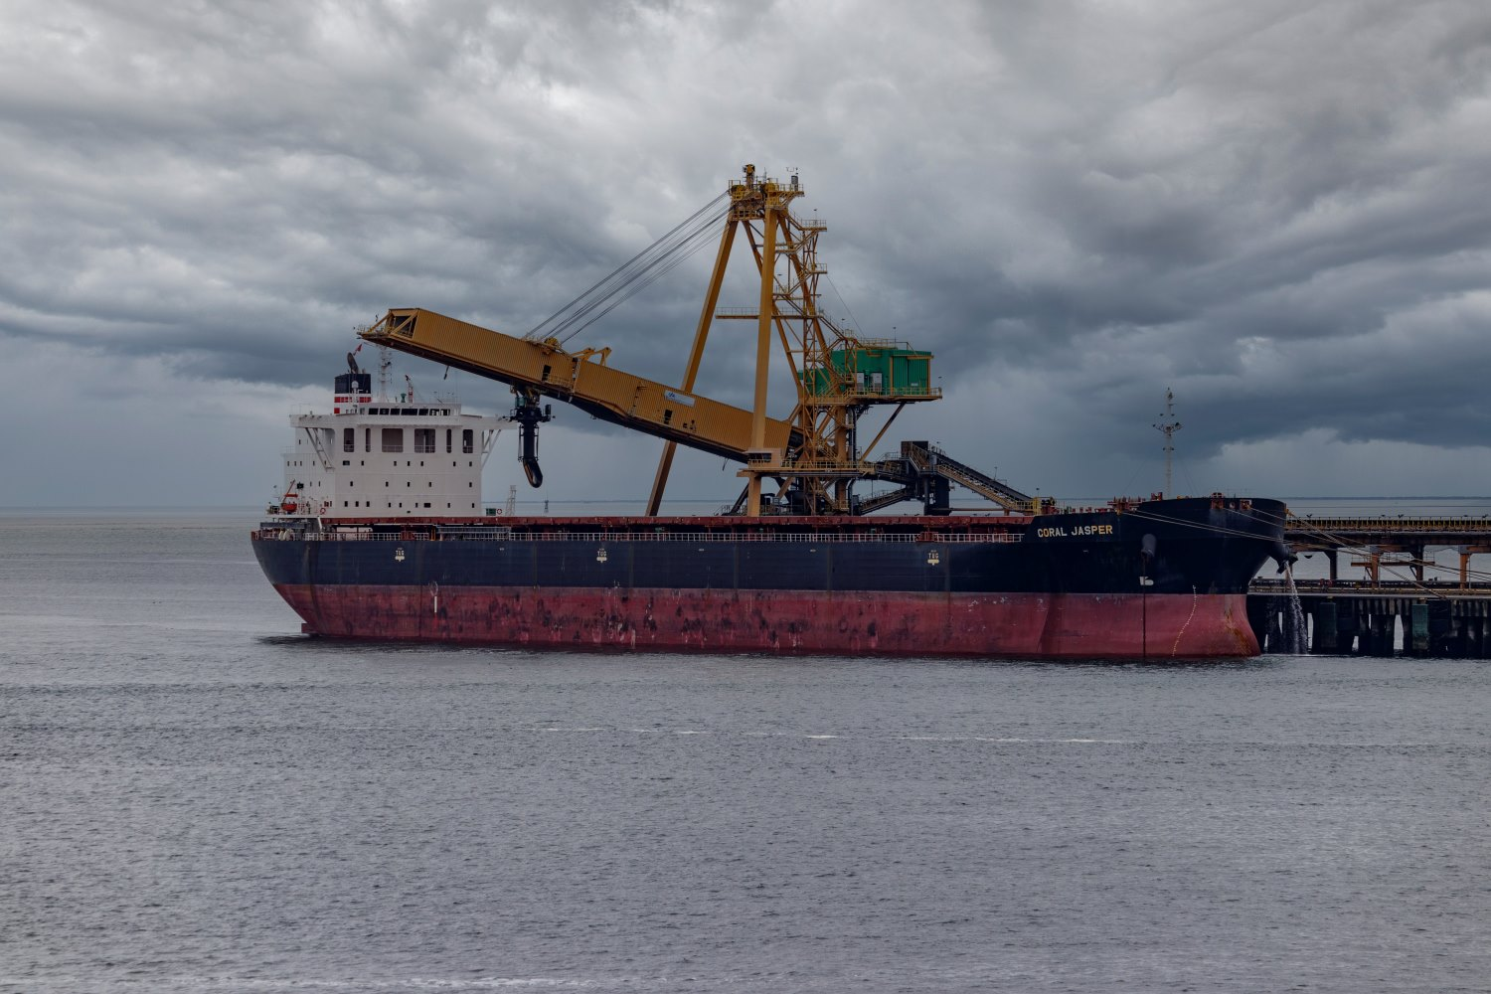
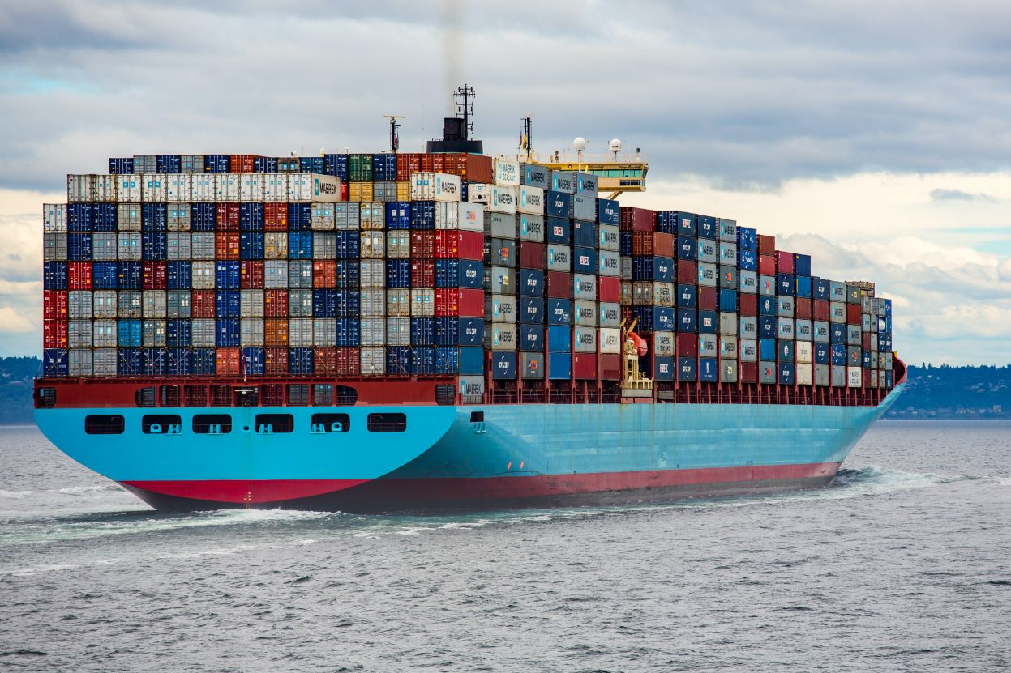
Shipping in the Baltic?
BSSSC Annual Conference 2023
Notes:
100 000 I världen
How many are in the Baltic at any given moment – 2 000 – 2%
In a month around 4 000 different.
How much of the goods is in the Baltic – 15% - Kolla HELCOM

Slide 3
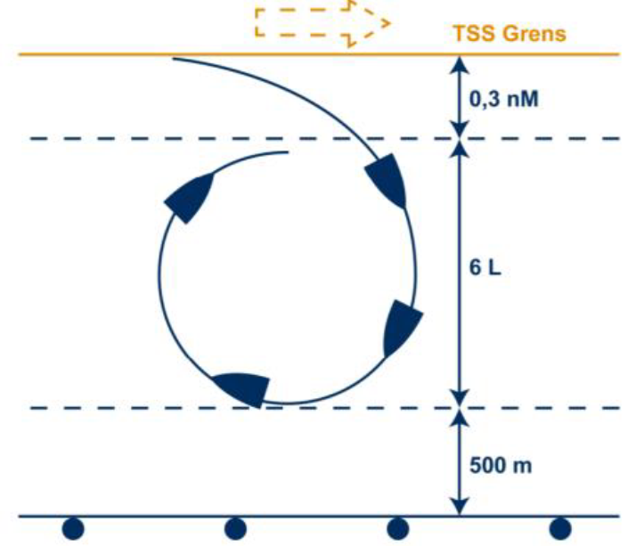
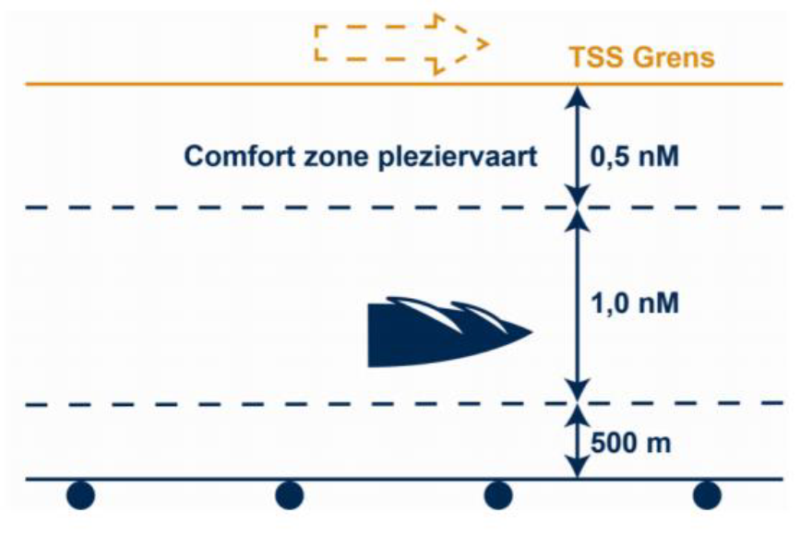
Safety distance according to international law (and Dutch practice)
BSSSC Annual Conference 2023

Slide 4
Ooopsy – by Dutch Department of Energy
BSSSC Annual Conference 2023

Slide 5
Where do we put the wind farms?
BSSSC Annual Conference 2023

Slide 6
Where are ships sailing
BSSSC Annual Conference 2023
Bild HELCOM ev bild farleder I Östersjön

Slide 7
Winter Navigation
BSSSC Annual Conference 2023
Sjöfart på vintern – klick - vindparksplaner

Slide 8
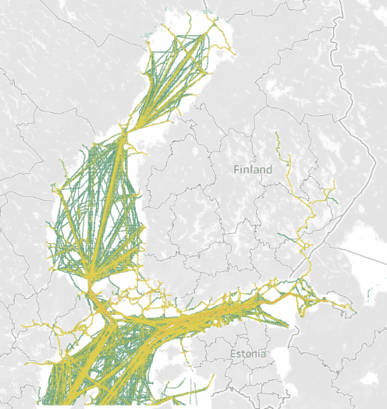
Winter Navigation
BSSSC Annual Conference 2023
Sjöfart på vintern – klick - vindparksplaner

Slide 9
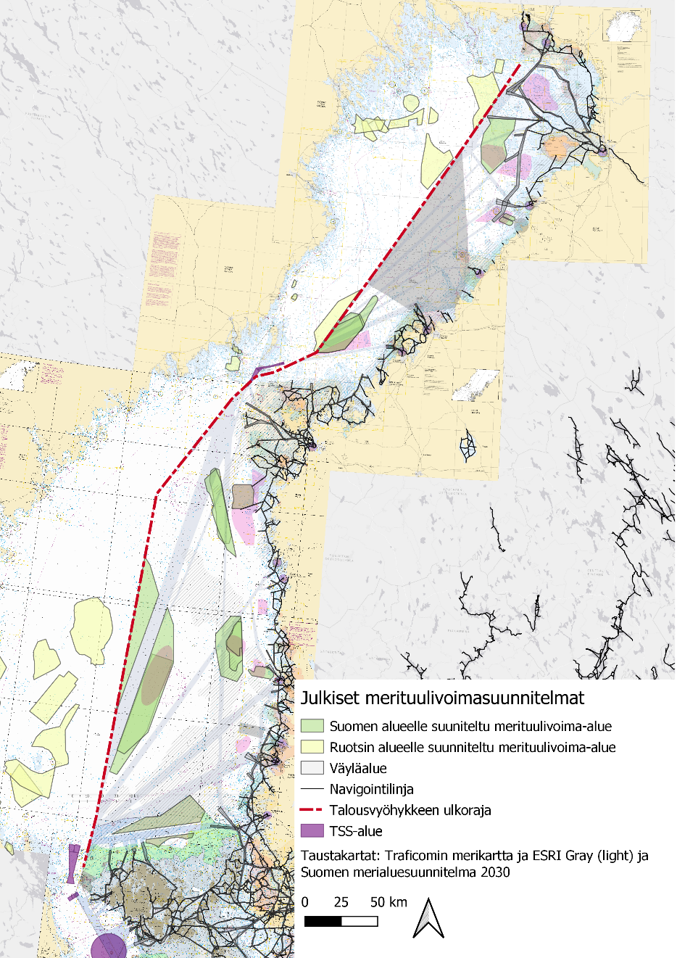

Slide 10
Animation of merchant vessel tracks during a hard winter
2010-2011

Slide 11
Merchant vessel tracks during an easy winter
2021-2022

Slide 12
Friends or Foes?
BSSSC Annual Conference 2023
What do shipping customers want?
24/7 operations – the cost of processing industry standing still
Cost efficient operations – to be competitive
Green energy – to be competitive in the future (green steel mills, battery factories, etc)
Shipping needs to fulfil what customers want:
We need to be 24/7 operational and cost efficient
=> Wind farms must not block shipping
=> If wind farms make shipping more costly, make sure who pays beforehand
We and our customers need to use green fuels in the future
=> We are Friends

Slide 13
Friends or Foes?
BSSSC Annual Conference 2023
What do shipping customers want?
24/7 €€ Green
Shipping needs to fulfil what customers want:
24/7 => Wind farms must not block shipping
€€ => If wind farms make shipping costly, who pays
Green => We want a future too.
Shipping is friends – what about wind farms?
Notes:
What do shipping customers want?
24/7 operations – the cost of processing industry standing still
Cost efficient operations – to be competitive
Green energy – to be competitive in the future (green steel mills, battery factories, etc)
Shipping needs to fulfil what customers want:
We need to be 24/7 operational and cost efficient
=> Wind farms must not block shipping
=> If wind farms make shipping more costly, make sure who pays beforehand
We and our customers need to use green fuels in the future
=> We are Friends

Slide 14
Dziękuję - THANK YOU!
Notes:
jen-KOO-yeh

