Slide 1
Interreg Baltic Sea Region: current status and programming
BSSSC Annual Conference
on-line | 30 September – 1 October 2020
Interreg BSR Managing Authority/Joint Secretariat

Slide 2
Interreg Baltic Sea Region 2014-2020: brief overview
Interreg Baltic Sea Region 2021-2027: update on state of programming

Slide 3
Interreg Baltic Sea Region 2014-2020: brief overview
BSSSC Annual Conference
on-line | 30 September – 1 October 2020
Interreg BSR Managing Authority/Joint Secretariat

Slide 4
Funding from three sources
Norwegian national funding EUR 4.6 million
European Neighbourhood Instrument & Russian national funding
EUR 6.9 million
European Regional Development Fund
EUR 243.8 million
BSSSC Annual Conference, 30 September – 1 October 2020
Interreg BSR Managing Authority/Joint Secretariat

Slide 5
Interreg Baltic Sea Region
In a nutshell
EUR 282.4 million
140 projects
> 1700 partners
BSSSC Annual Conference, 30 September – 1 October 2020
Interreg BSR Managing Authority/Joint Secretariat

Slide 6
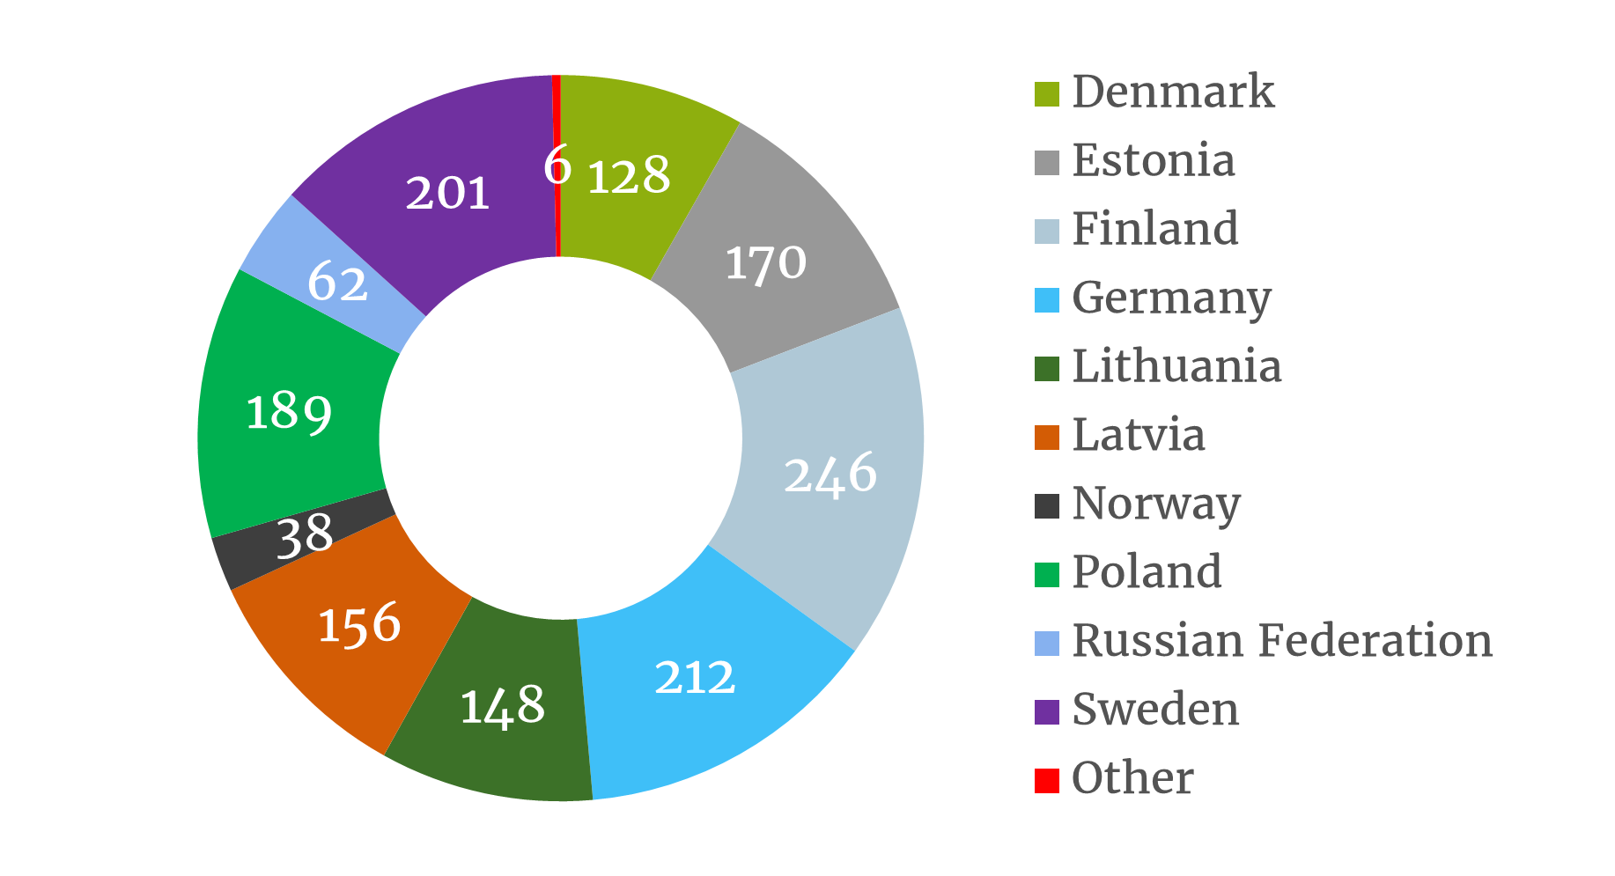
Partner organisations in different countries

Slide 7
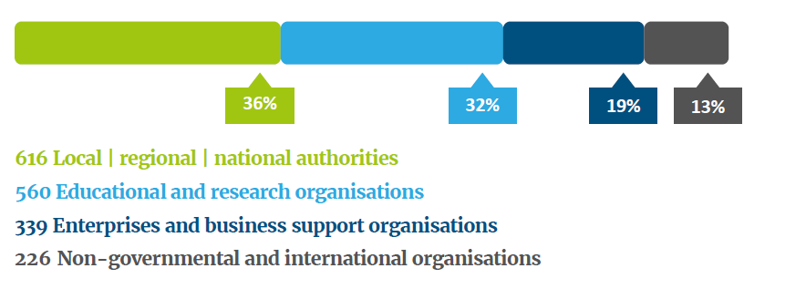
Over 1700 partners working together

Slide 8
Priorities and Objectives
Transport
Interoperability
Accessibility
Maritime Safety
Shipping
Urban mobility
EU strategy support
Seed money
Support of PACs & HACs
Targeted support & EUSBSR forums
Natural resources
Clear waters
Renewable energy
Energy efficiency
Blue growth
Innovation
Research & innovation infrastructures
Smart specialisation
Non-technological innovation

Slide 9
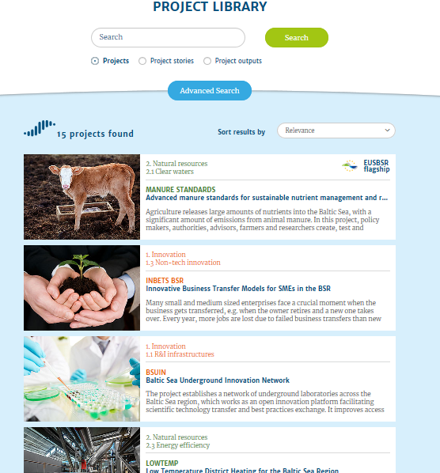
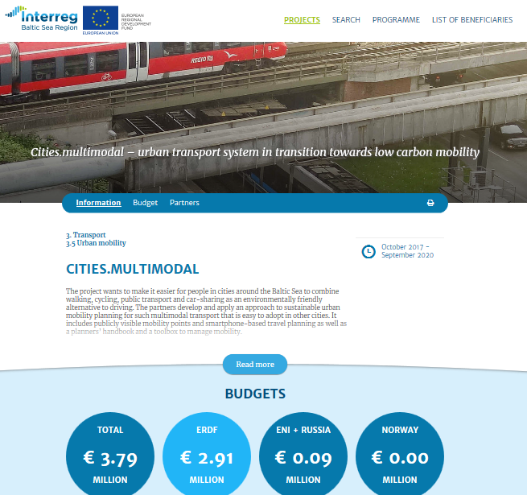
Project library - ongoing and finalised projects
projects.interreg-baltic.eu

Slide 10
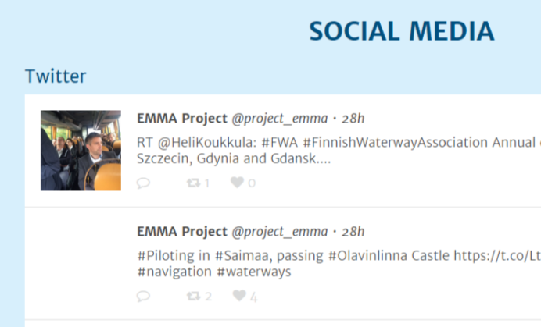
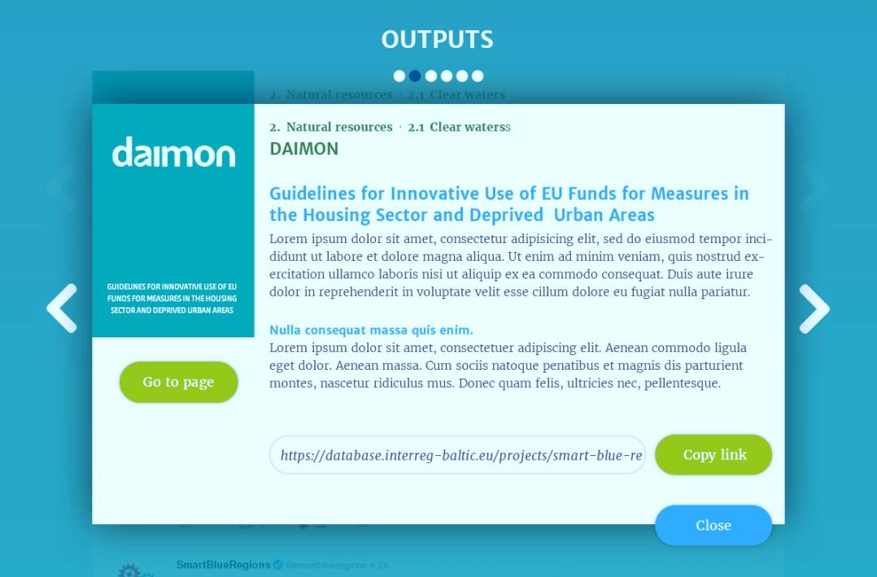
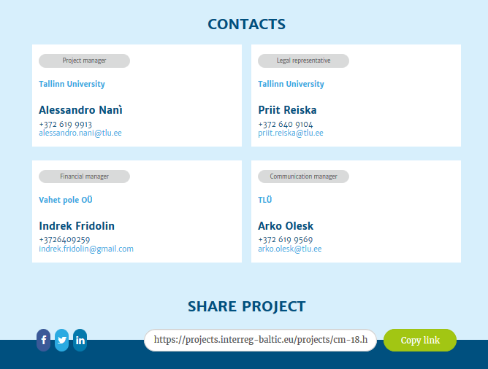
Project library – dynamic content

Slide 11
Interreg Baltic Sea Region 2021-2027: update on state of programming
BSSSC Annual Conference
on-line | 30 September – 1 October 2020
Interreg BSR Managing Authority/Joint Secretariat

Slide 12
Programming process
Identification of main needs for transnational cooperation (September-November 2019)
Programme vision (September 2019-March 2020)
Draft of the thematic framework of the Programme (June 2020)
Public consultations (13th July – 4th September 2020)
Endorsement of the Programme draft
National approval procedure
(from March 2021)
Notes:
(April-June 2020)

Slide 13
Programming process
Submission of the Programme to the European Commission
*
Start of the new Programme
(end 2021)
*
First call for project applications
(end 2021)
*
Given that the MFF
is in place in due time
BSSSC Annual Conference, 30 September – 1 October 2020
Interreg BSR Managing Authority/Joint Secretariat

Slide 14
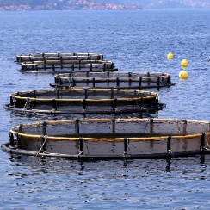
Thematic overview for public consultation
Innovative and resilient economies and societies and responsive public services
Sustainable use of the Baltic Sea and regional water resources adapted to the impacts of climate change
Climate change mitigation
Policy Objective 1: A smarter Europe
Policy Objective 2: A greener Europe
Policy Objective 2:
A greener Europe
1.
2.
3.
4.
5.
6.
7.

Slide 15
Our approaches for the future
● clearer focus on target groups and implementation (pilot actions)
● simplification in reporting and controls (simplified cost options)
© PantherMedia Stock Agency/tomwang

Slide 16
BSSSC Annual Conference
Managing Authority/ Joint Secretariat Phone +49/381 45 484 5230 e-mail: marina.kislyak@interreg-baltic.eu www.interreg-baltic.eu

